Slide 1


Spring and Hibernate

Slide 2


Today's session covers....?
1
What is spring framework ?
Spring MVC
2
Spring Boot and Microservices
3
What is Hibernate ?
4
Notes:
では実際に、今日の戦略計画はなぜ複雑なのでしょうか？

Slide 3


Spring Framework

Slide 4


What is Spring Framework?
Spring Framework is a Java platform that provides comprehensive infrastructure support for developing Java applications. Spring handles the infrastructure so you can focus on your application.
Spring enables you to build applications from “plain old Java objects” (POJOs) and to apply enterprise services non-invasively to POJOs. This capability applies to the Java SE programming model and to full and partial Java EE.
Examples of how you, as an application developer, can use the Spring platform advantage:
Make a Java method execute in a database transaction without having to deal with transaction APIs.
Make a local Java method a remote procedure without having to deal with remote APIs.
Make a local Java method a management operation without having to deal with JMX APIs.
Make a local Java method a message handler without having to deal with JMS APIs

Slide 5
Spring MVC

Slide 6
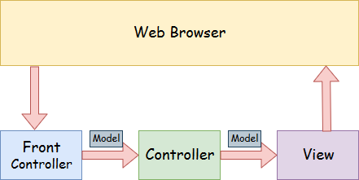
What is Spring MVC?
A Spring MVC is a Java framework which is used to build web applications . It follows the Model-View-Controller design pattern.
A Spring MVC provides an elegant solution to use MVC in spring framework by the help of DispatcherServlet. Here, DispatcherServlet is a class that receives the incoming request and maps it to the right resource such as controllers, models, and views.
Model – View – Controller : -

Slide 7
What is Spring MVC?
Following is the sequence of events corresponding to an incoming HTTP request to DispatcherServlet −
After receiving an HTTP request, DispatcherServlet consults the HandlerMapping to call the appropriate Controller.
The Controller takes the request and calls the appropriate service methods based on used GET or POST method. The service method will set model data based on defined business logic and returns view name to the DispatcherServlet.
The DispatcherServlet will take help from ViewResolver to pickup the defined view for the request.
Once view is finalized, The DispatcherServlet passes the model data to the view which is finally rendered on the browser.
All the above-mentioned components, i.e. HandlerMapping, Controller, and ViewResolver are parts of WebApplicationContext w which is an extension of the plainApplicationContext with some extra features necessary for web applications.

Slide 8
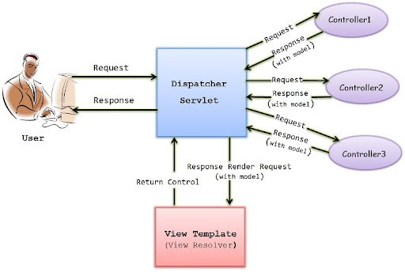
Spring MVC architecture

Slide 9
Spring MVC architecture
Model - A model contains the data of the application. A data can be a single object or a collection of objects.
Controller - A controller contains the business logic of an application. Here, the @Controller annotation is used to mark the class as the controller.
View - A view represents the provided information in a particular format. Generally, JSP+JSTL is used to create a view page.
Front Controller - In Spring Web MVC, the DispatcherServlet class works as the front controller. It is responsible to manage the flow of the Spring MVC application.
Flow of Spring MVC :-
Request(Frontend) <---------> Controller <--------> Service <---------> Dao
Controller :- Use @Controller annotation to mark the class as the controller. This layer directly communicate with service layer.
Service :- Use @Service annotation to mark the class as the service. Service layer contain only abstract method and serviceimpl layer contain business logic of the application.
Dao :- use @Repository annotation to mark the class as the dao. Dao contain all the abstract method where daoimpl contain all the database related queries for CRUD operation.

Slide 10
Annotations of Spring MVC
@Autowired : -This annotation is applied on fields, setter methods, and constructors. The @Autowired
annotation injects object dependency implicitly.
@Controller :-The @Controller annotation is used to indicate the class is a Spring controller. This annotation can be used to identify controllers for Spring MVC.
@Service :- This annotation is used on a class. The @Service marks a Java class that performs some service, such as execute business logic, perform calculations and call external APIs.
@RequestMapping :- This annotation is used both at class and method level. The @RequestMapping
annotation is used to map web requests onto specific handler classes and handler methods. When @RequestMapping is used on class level it creates a base URI for which the controller will be used.
@GetMapping/@PostMapping : -This annotation is used for mapping HTTP GET or POST requests onto specific handler methods.
@Transactional :- This annotation is placed before an interface definition, a method on an interface, a class definition, or a public method on a class. The mere presence of @Transactional is not enough to activate the transactional behaviour.
@RequestBody :- This annotation is used to annotate request handler method arguments. The @RequestBody annotation indicates that a method parameter should be bound to the value of the HTTP request body.

Slide 11
What is Hibernate
Hibernate is a Java framework that simplifies the development of Java application to interact with the database. It is an open source, lightweight, ORM (Object Relational Mapping) tool.
Hibernate overcome all the problems of JDBC.
Features :-
Open Source and Lightweight
Fast Performance
Database Independent Query
Automatic Table Creation
Simplifies Complex Join
Provides Query Statistics and Database Status

Slide 12
Spring With Hibernate
CRUD operation Methods :-
Some common methods are used in our platform
saveModel () - Method to save the data to the respective table
Input parameter: Object obj, String className
Return: NA
updateModel () - Method to update the data to the respective table
Input parameter: Object obj, String className
Return: NA
deleteModel () - Method to delete the data from respective table
Input parameter: Object obj, String className
Return: NA

Slide 13
Spring Boot Microservices
Microservices, also known as Microservices Architecture, is basically an SDLC approach in which large applications are built as a collection of small functional modules. It is one of the most widely adopted architectural concepts within software development. In addition to helping in easy maintenance, this architecture also makes development faster. Additionally, microservices are also a big asset for the latest methods of software development such as DevOps and Agile. Furthermore, it helps deliver large, complex applications promptly, frequently, and reliably. Applications are modeled as collections of services, which are:
Maintainable and testable
Loosely coupled
Independently deployable
Designed or organized around business capabilities
Managed by a small team

Slide 14
Spring Boot Microservices
Spring Boot is a Spring module that provides the RAD (Rapid Application Development) feature to the Spring framework.
Spring Boot is an open-source Java-based framework used to create microservices and production-ready standalone Spring MVC applications.
Microservices :- a complex task is distributed into multiple tasks or services, and each task is developed and managed independently to support business applications.
Micro services provide different methods for save ,fetch, update and delete.
Features : -
Create stand-alone Spring applications
Embed Tomcat, Jetty or Undertow directly (no need to deploy WAR files)
Provide opinionated 'starter' dependencies to simplify your build configuration
Automatically configure Spring and 3rd party libraries whenever possible
Provide production-ready features such as metrics, health checks, and externalized configuration
Absolutely no code generation and no requirement for XML configuration

Slide 15

Thank you
Japan
c/o In Control,
ARK Hills Front Tower RoP 806,
2-23-1 Akasaka, Minato-ku,
Tokyo, Japan 107-0052,
United States
691, S Milpitas Blvd., Suite #217, Milpitas, CA, 95035
India
#221, 2nd Floor, 7th Main, 2nd Block,
HRBR Layout, Kalyan Nagar, Bengaluru, Karnataka, Pin-560043
China
Rm1306, Zhonghuang Bldg, No1007, 2nd South Zhongshan Rd, Shanghai, 200030, China
Phone
+1 651 204 2720
+91 80 4372 3204
+86 13381926699
E-Mail
info@ideapoke.com
sales@ideapoke.com

